Slide 1
SELF INTRODUCTION
Show Time

Slide 2
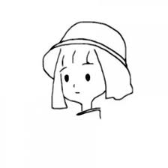
Basic Information
Yao Lan
Female
Short hair and medium build
Freshman in XMUM
Outgoing and steady
This’s me.
I’d like to make friends with you.

Slide 3


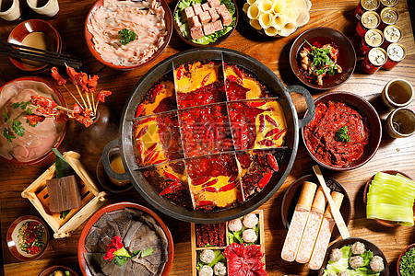
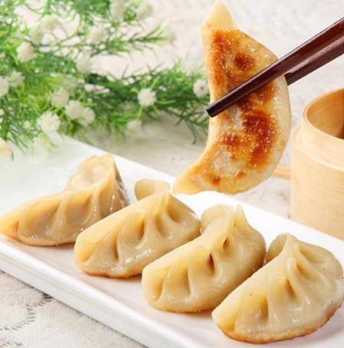

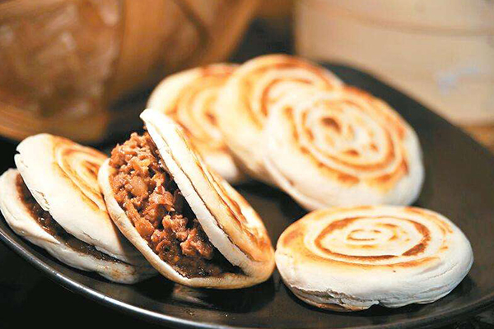
My Favorites
Reading novels
Such as:
Eating delicious food
Such as:

Slide 4

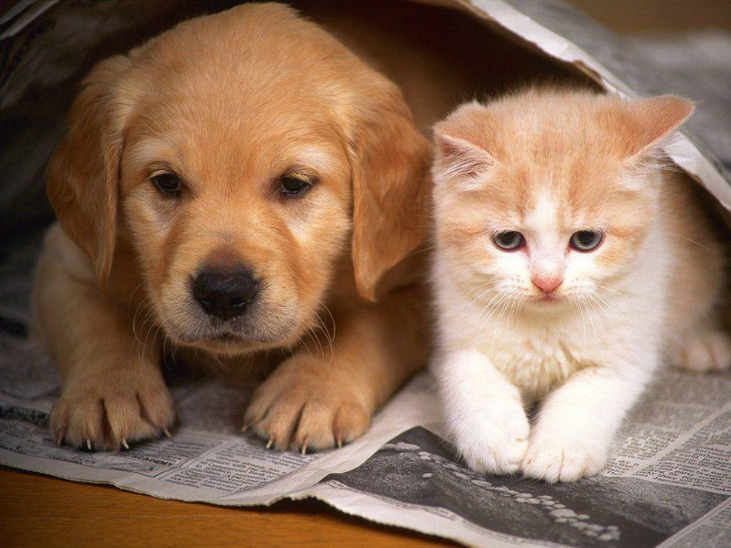


My Favorites
Running
And so on…..
Programming (????)
Maybe…
Playing with pets

